Slide 1
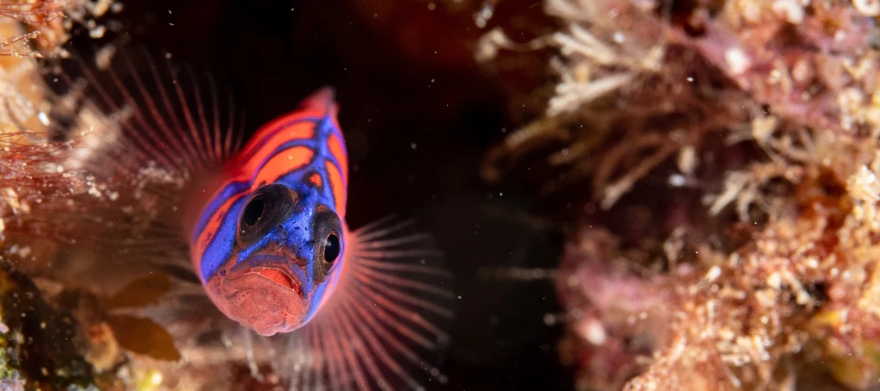
Evaluating the effects of predation risk on fitness in a temperate reef fish
George Jarvis & Mark Steele
California State University, Northridge
2019 Benthic Ecology Meeting | St. John’s, Canada
Notes:
Interested in the effects of environmental factors, such as predation risk, may influence prey fitness over time

Slide 2
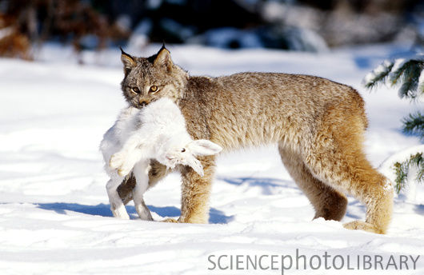
Predation influences prey fitness
Two types
Lethal: direct removal of reproductive individuals
Sublethal: predation risk alters reproductive behavior
Maximize current or future fitness?
Few studies on risk in marine fishes
www.geocaching.com
Reviewed by Peckarsky et al. 2008
Notes:
Solid
(when text changes color) I’m really interested in these sublethal effects of predators b/c they affect more than one individual in a population
When faced with risk, prey have to decide whether to maximize current or future fitness
Usually depends on an organisms reproductive plasticity, and ability to adapt to risk
More plastic = likely to suppress, and prioritize current fitness
Less plastic = less likely to suppress, prioritize future fitness
d. well-studied in terrestrial and aquatic systems, but lack of equivalent studies in marine fishes
a. In field: decreased herbivory in response to mimics = reduced fitness?
b. In lab, prey act differently, predators act differently, not super realistic
though studies in lab reflect tend to follow theory of reproductive plasticity mentioned before
T: One fish species that is attractive for studying the effects of risk on reproduction is the bluebanded goby

Slide 3
Theory
Risk allocation hypothesis
Maximize current or future fitness?
Well studied in terrestrial and aquatic systems, not so much in marine fishes
Notes:
Solid
(when text changes color) I’m really interested in these sublethal effects of predators b/c they affect more than one individual in a population
When faced with risk, prey have to decide whether to maximize current or future fitness
Usually depends on an organisms reproductive plasticity, and ability to adapt to risk
More plastic = likely to suppress, and prioritize current fitness
Less plastic = less likely to suppress, prioritize future fitness
d. well-studied in terrestrial and aquatic systems, but lack of equivalent studies in marine fishes
a. In field: decreased herbivory in response to mimics = reduced fitness?
b. In lab, prey act differently, predators act differently, not super realistic
though studies in lab reflect tend to follow theory of reproductive plasticity mentioned before
T: One fish species that is attractive for studying the effects of risk on reproduction is the bluebanded goby

Slide 4
Few studies on risk in marine fishes
Field experiments mostly correlative (herbivores grazing less in high risk settings = lower fitness?)
Lab experiments lack biological realism (magnhagen studies)
But lab studies have shown that response of fish to predators relies heavily on their life history (reproductive plasticity), which is consistent with evolutionary theory
Potential models to study risk in marine fishes?
www.geocaching.com
Notes:
Solid
(when text changes color) I’m really interested in these sublethal effects of predators b/c they affect more than one individual in a population
When faced with risk, prey have to decide whether to maximize current or future fitness
Usually depends on an organisms reproductive plasticity, and ability to adapt to risk
More plastic = likely to suppress, and prioritize current fitness
Less plastic = less likely to suppress, prioritize future fitness
d. well-studied in terrestrial and aquatic systems, but lack of equivalent studies in marine fishes
a. In field: decreased herbivory in response to mimics = reduced fitness?
b. In lab, prey act differently, predators act differently, not super realistic
though studies in lab reflect tend to follow theory of reproductive plasticity mentioned before
T: One fish species that is attractive for studying the effects of risk on reproduction is the bluebanded goby

Slide 5
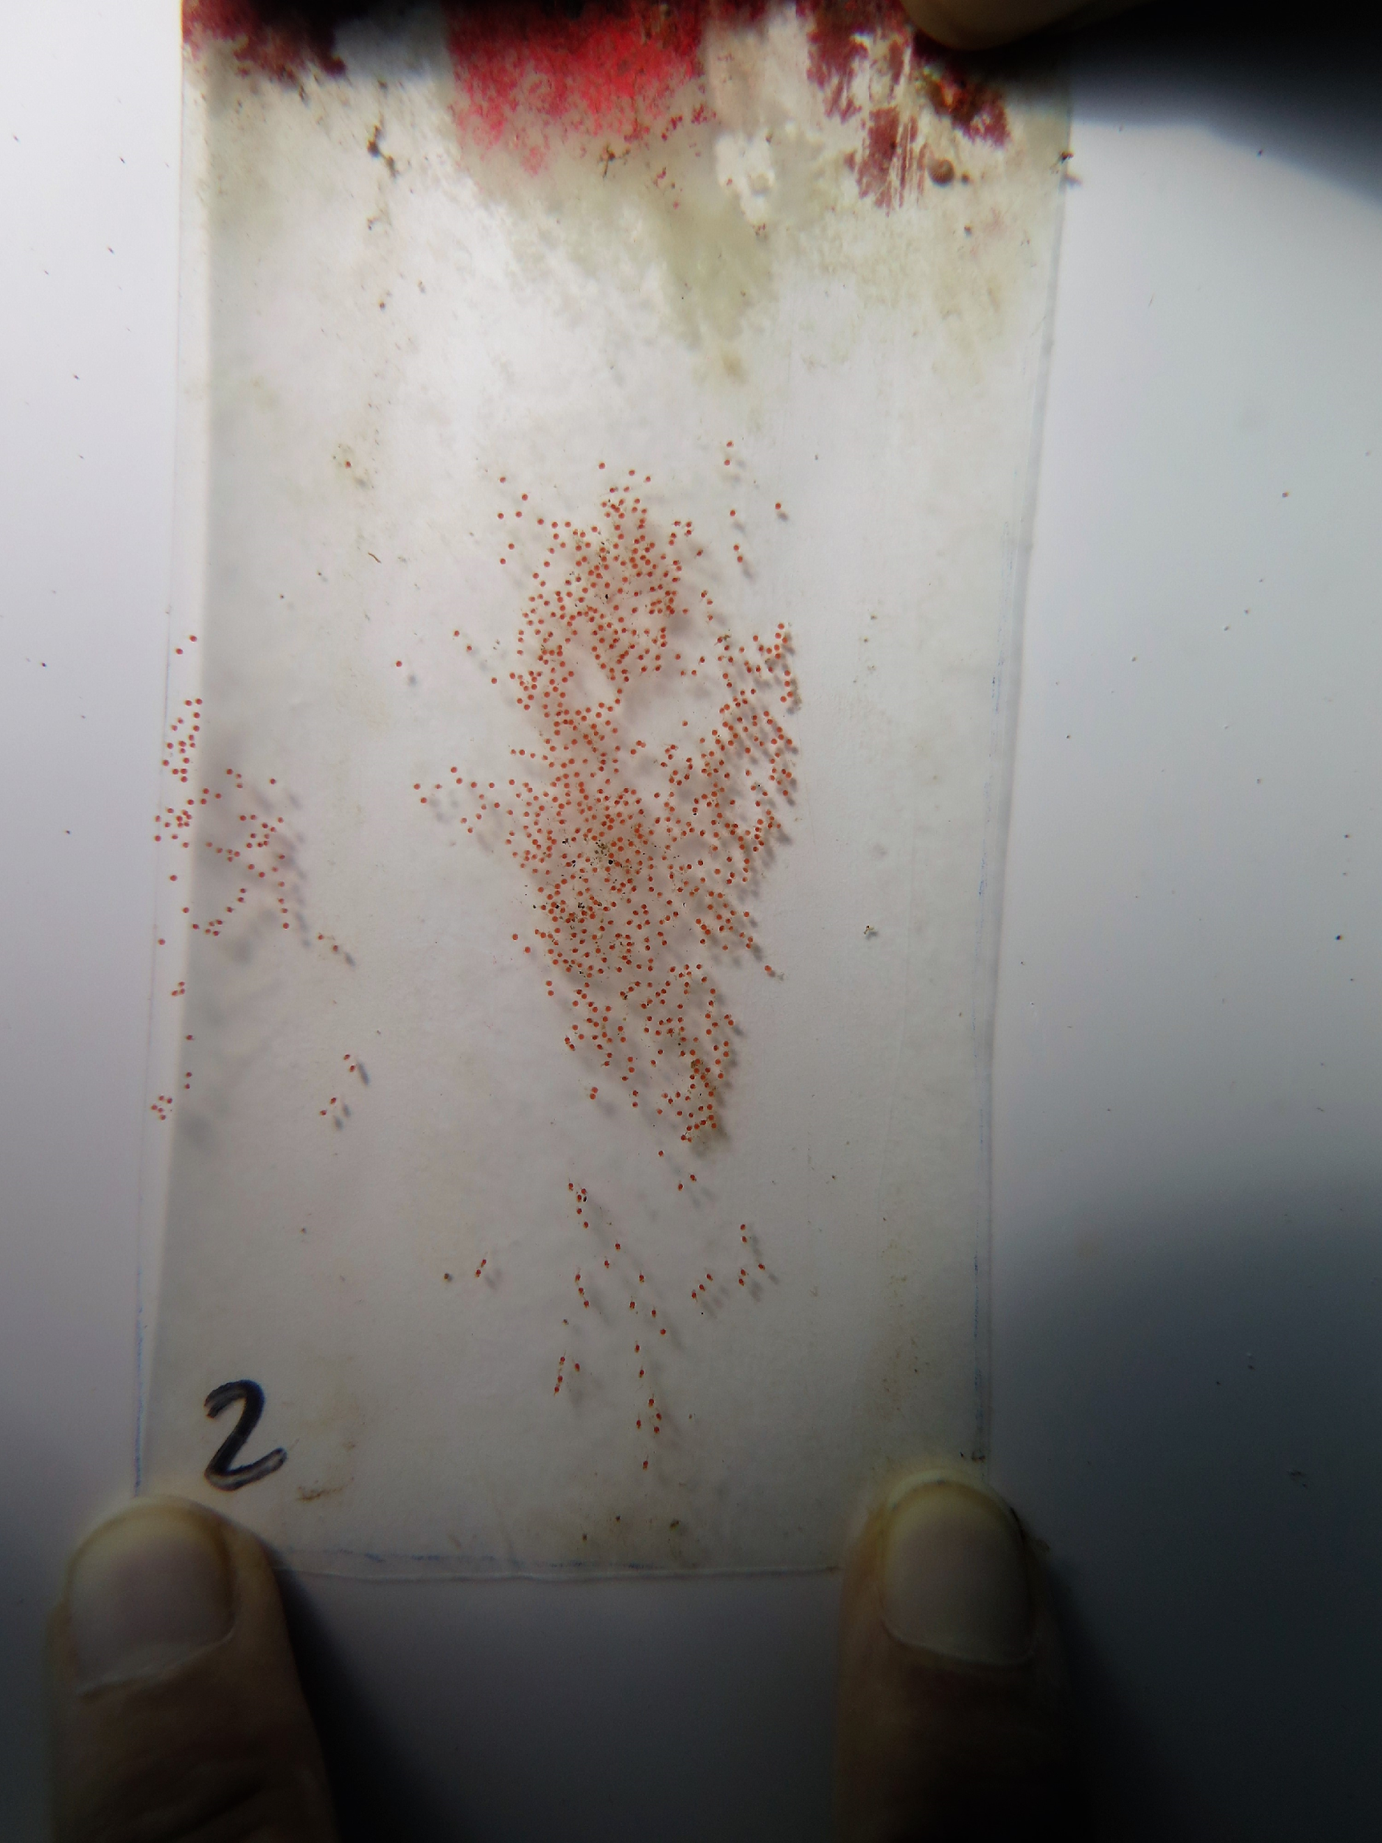
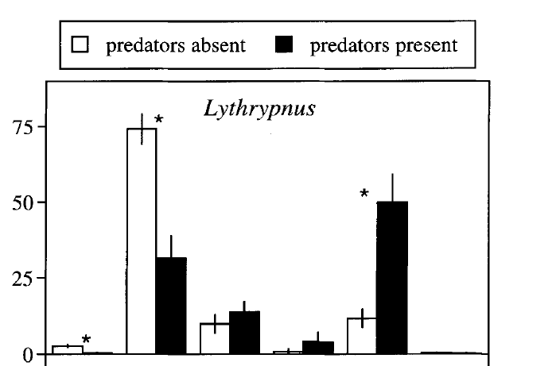
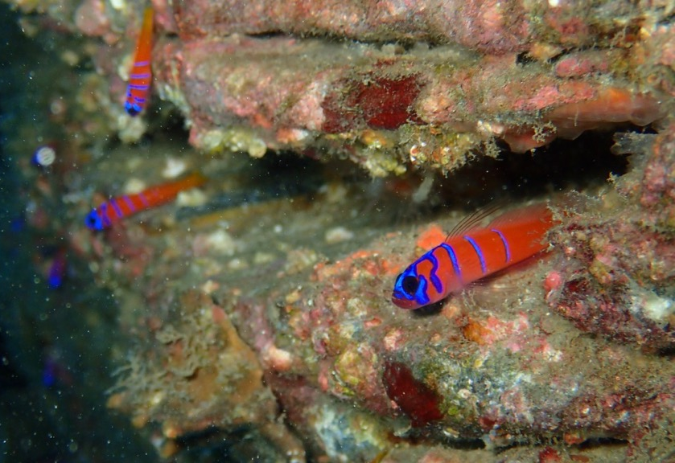
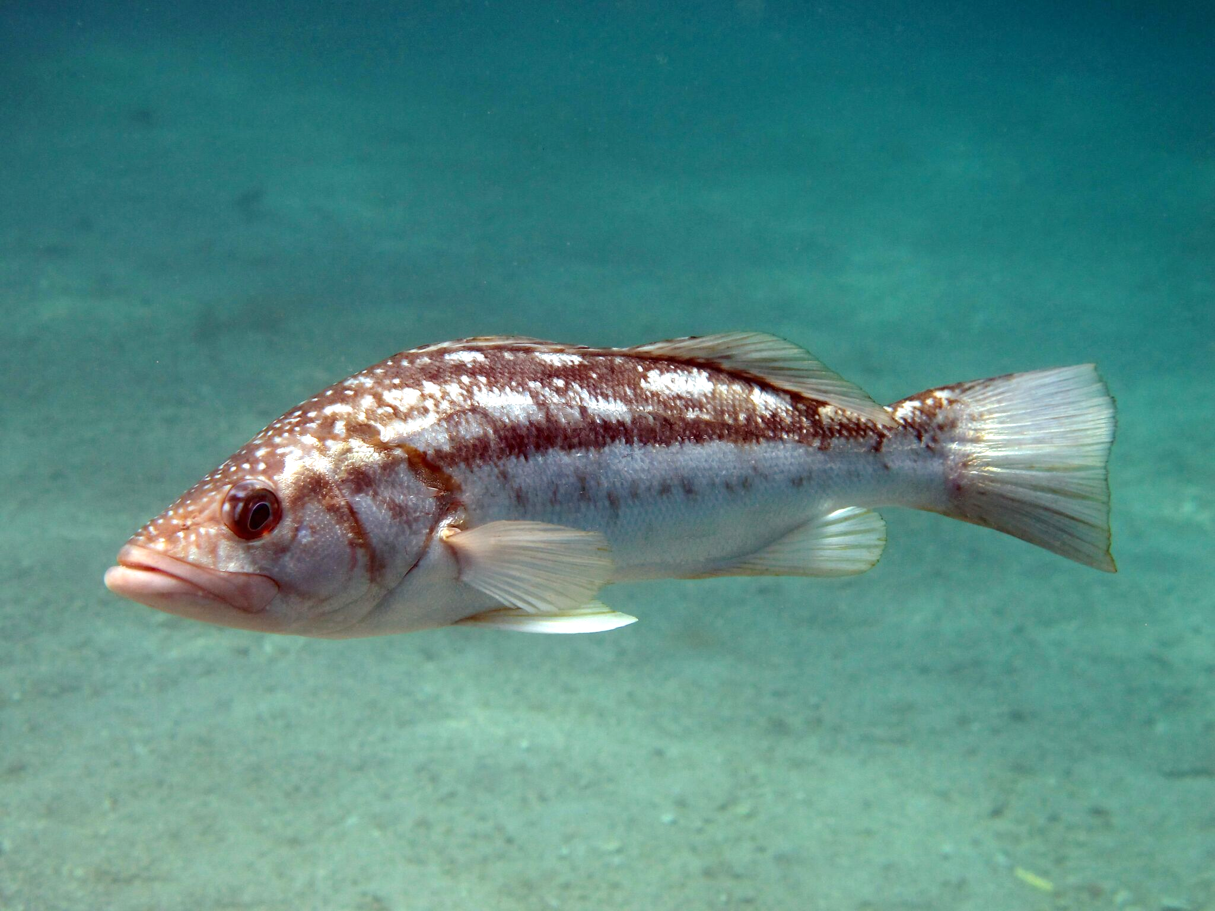
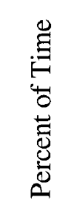
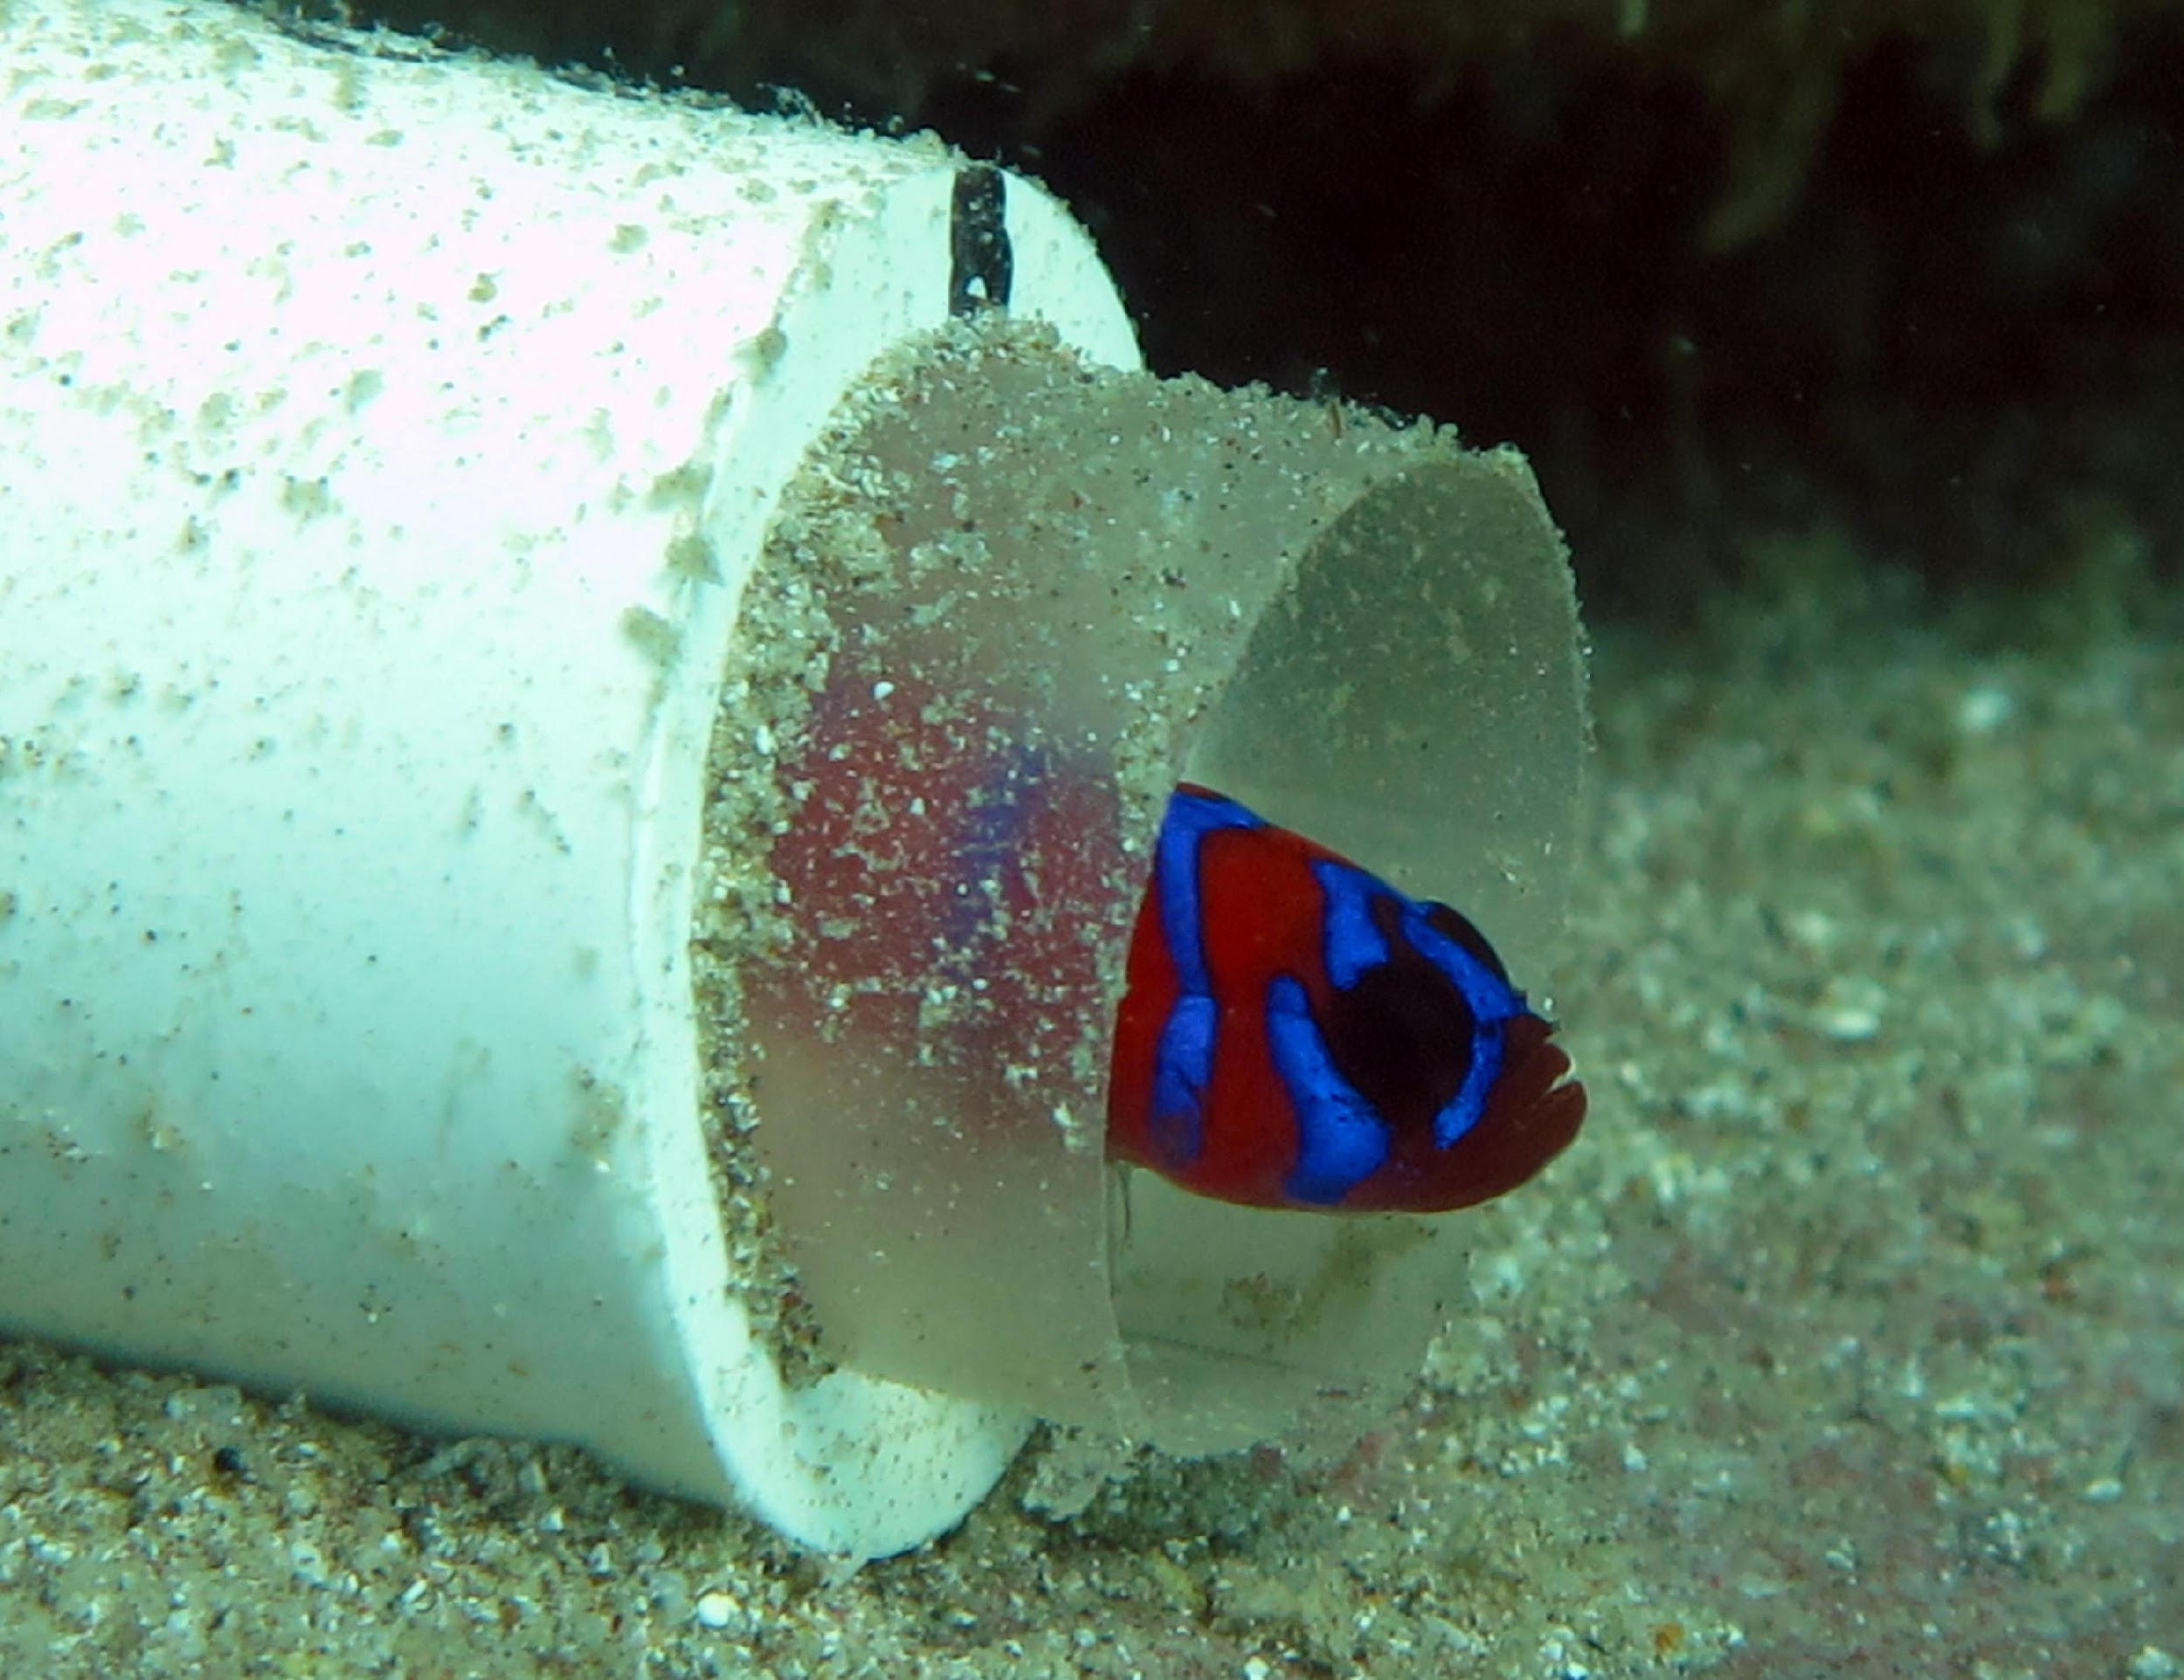
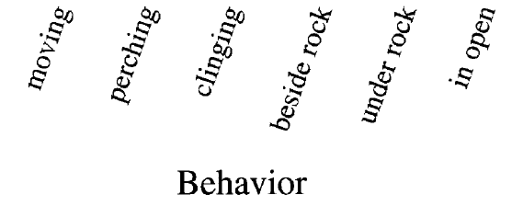
Bluebanded goby (Lythrypnus dalli)
___
1 cm
Brood-spawning fish
Exhibits predator avoidance behaviors
Scott Hamilton
Steele 1998
Scott Hamilton
Griffin Srednick
Scott Hamilton
Steele 1998
Notes:
Highly abundant reef-fish, Eastern pacific, Central California to Peru
been used in a number of demographic studies in fishes
Stay in one place, relatively easy to transplant for manipulative experiments
Live to be 2 years old, reproduce for 8 months during their life
Good for running replicate studies in a single field season
Low reproductive plasticity → less likely to suppress reproduction?
(photo) typically how you see BBG, perching is important for foraging, vigilance to predators, and mating
High parental investment → females lay eggs, males fertilize and guard (nest photo)
Will spawn in artificial nests → allows me to directly measure reproductive output with egg counts
Responds to predation risk in field → kelp bass is predator of adult gobies
lower foraging and more time hiding
Will likely affect energy acquisition and coursthip

Slide 6
Expected effects of predation risk on bluebanded gobies
Reproduction
Fewer eggs produced
Behavior
Reduced fitness behaviors
Notes:
Based on previous work with this species, chose to look at three responses that would likely be affected by predation risk in bluebanded gobies
Just state
Just state
Based on previous work in this species (on effects of predators on BBG), and their highly social mating tendencies, I think that predator avoidance behaviors will severely affect foraging and courtship behaviors, leading to reductions in reproduction and survivorship
T: To try and simulate a more natural response of gobies to predators, I conducted a caging experiment in the field

Slide 7
1.5 m
Notes:
First I constructed a series of rocky reefs, standardized by the amount of rocks and number of artificial nests (shown as white cylinders) on each
Covered with one of three caging types to manipulate predator access to prey and perceived risk by gobies. Idea being, larger separation between predators and prey = less risky

Slide 8

Low risk
Medium risk
High risk
Low sublethal +
no lethal effects
High sublethal +
no lethal effects
High sublethal +
lethal effects
1.5 m
0.75 m
0.75 m
20 gobies per reef: 5 males + 15 females (5 gravid)
Notes:
Low risk treatment, reefs were covered with large cages that excluded predators at a far distance
Blue shading represents mesh that excluded predators, but was large enough for gobies to swim through (although reefs were separated from each other to limit emigration)
Observations suggest that predators excluded beyond this distance (~0.5m) do not induce changes in goby behavior
Med risk – same concept as low, excluded predators, but smaller cage allowed predators to get closer to prey
High risk, removed side panels of mesh to allow for full predator access
c. Populations were based off of natural size and sex ratios at the start of each trial
Key point: goal here was to keep all reefs and initial populations equal, except for the level of predator access

Slide 9
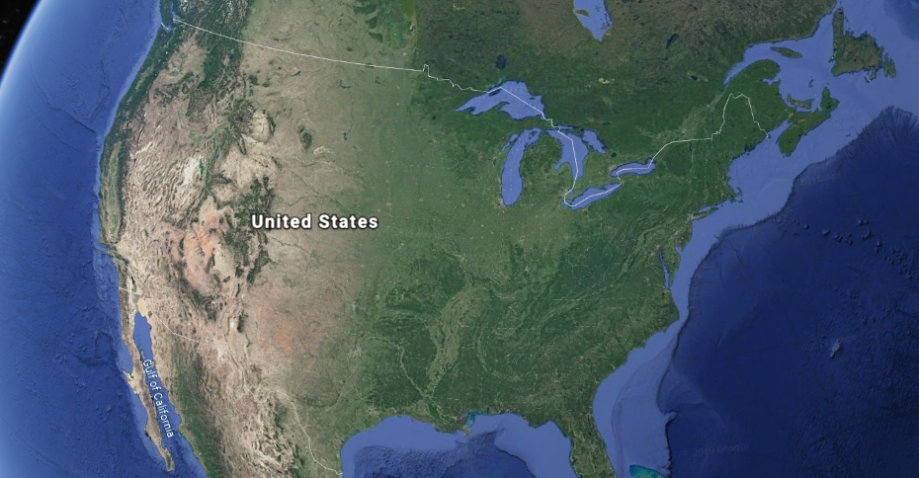
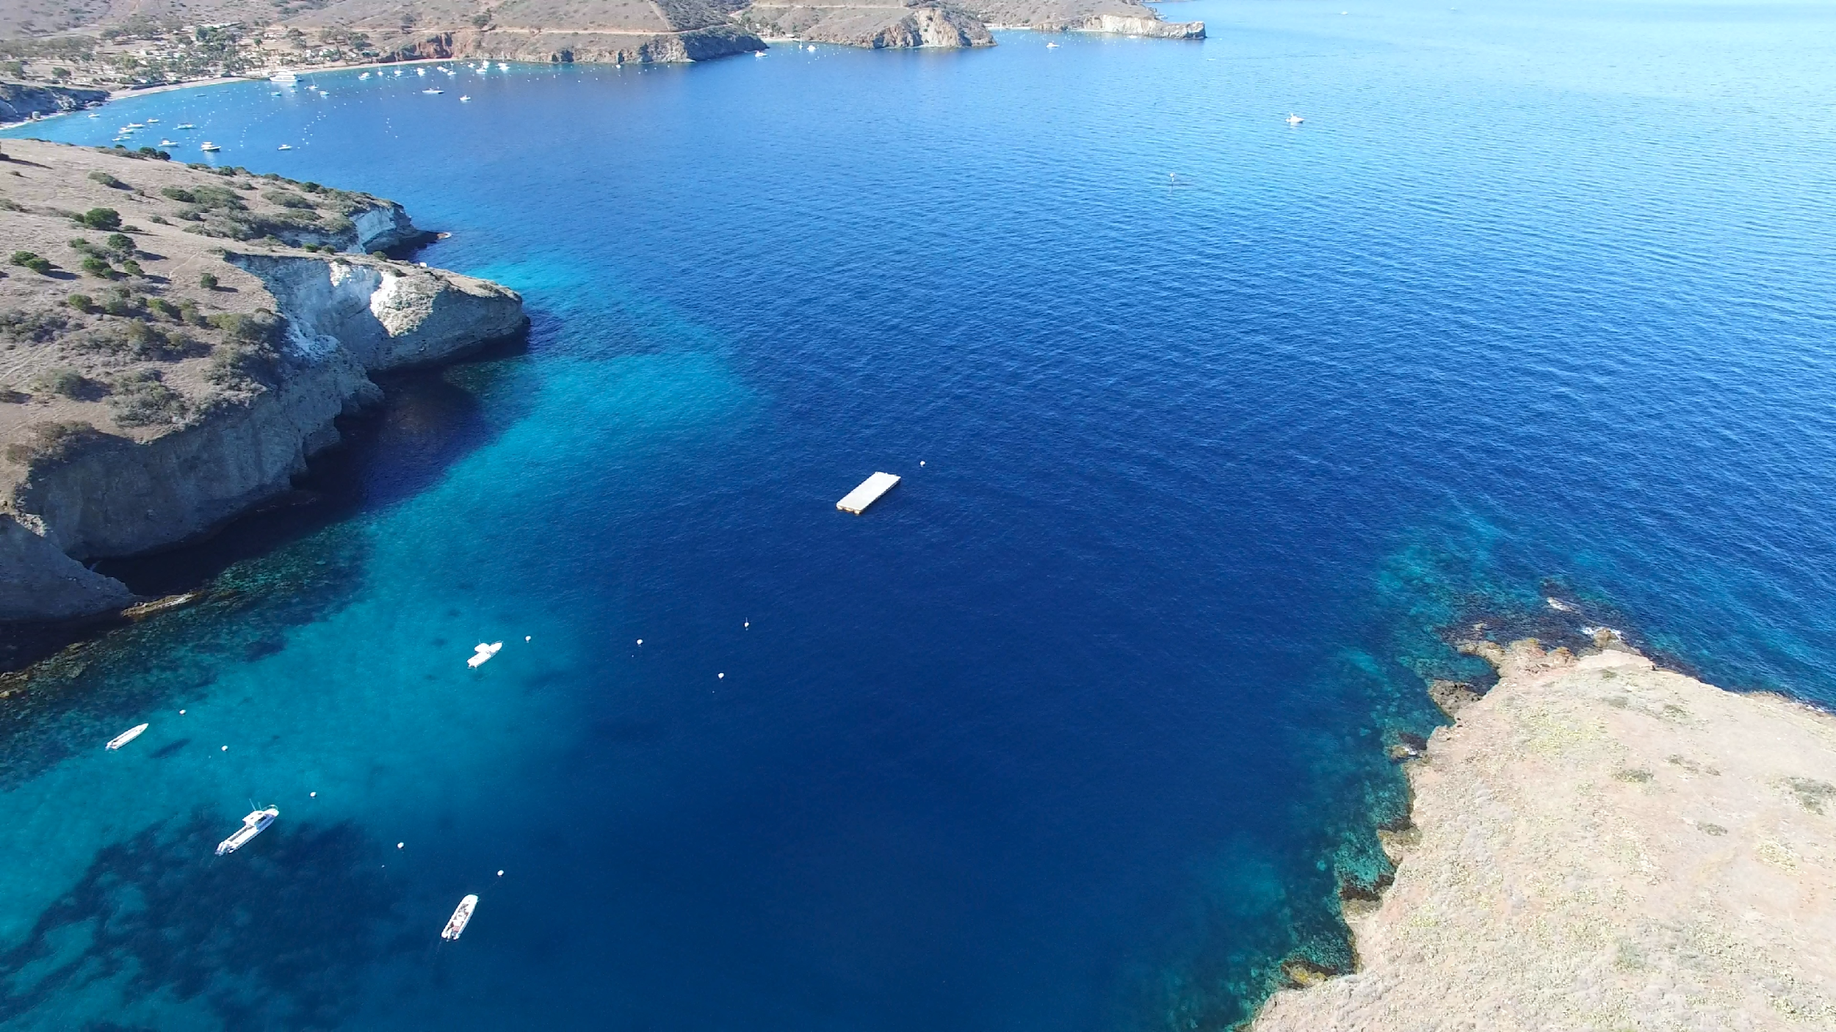

BEM!
Catalina Island
Catalina Island
500 km
18 reefs
6 low, 6 medium, 6 high
Month-long trials
Chris Lowe
500 km
Notes:
Ran experiment 2 times in the summer of 2018

Slide 10
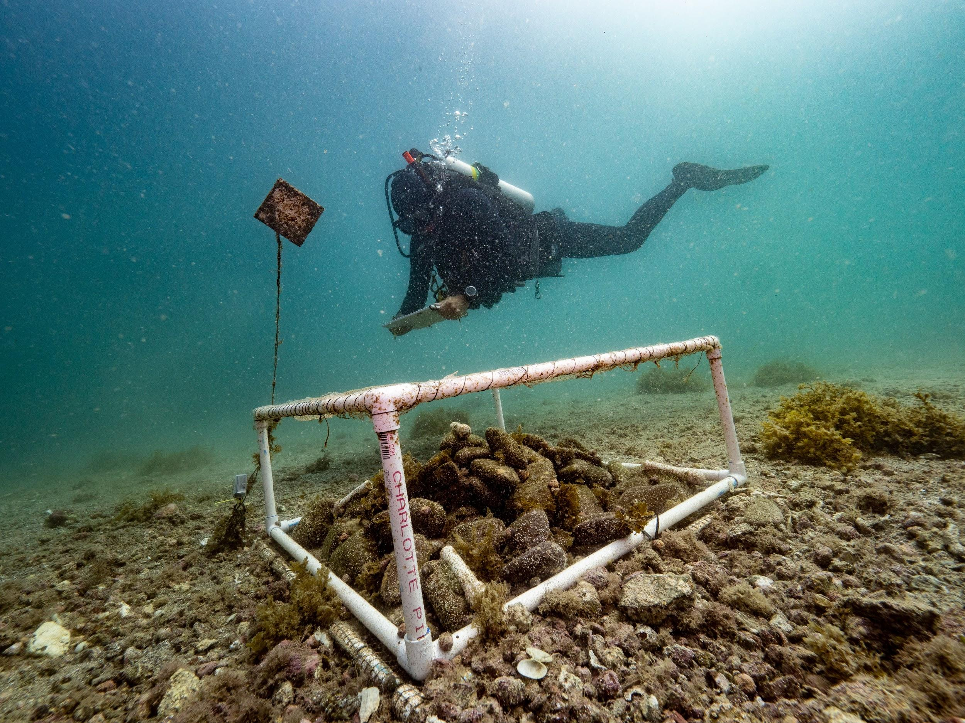
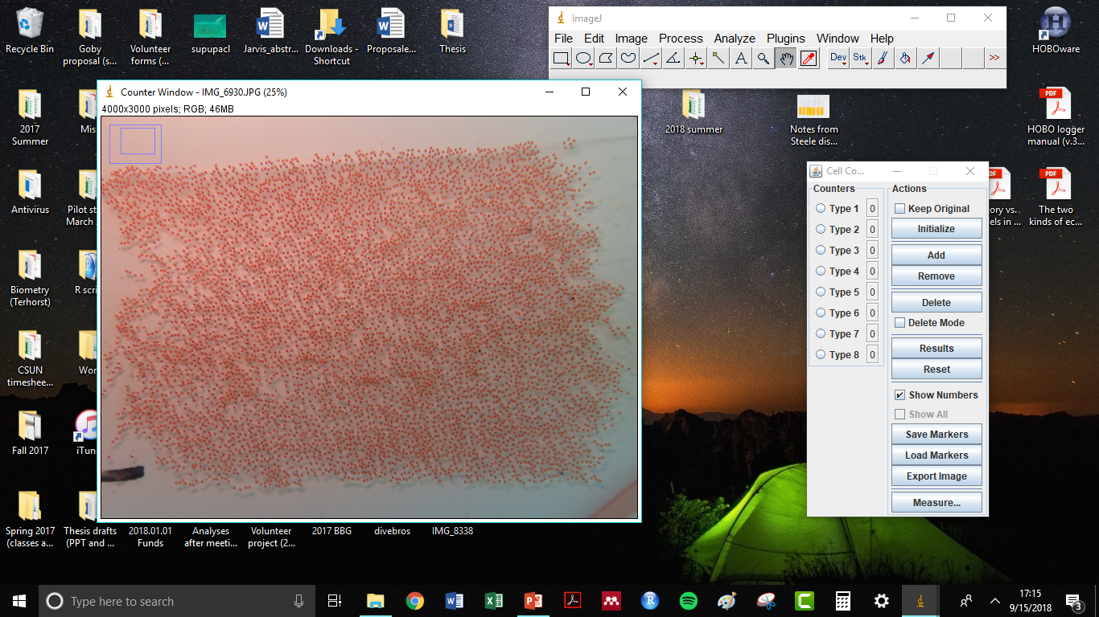
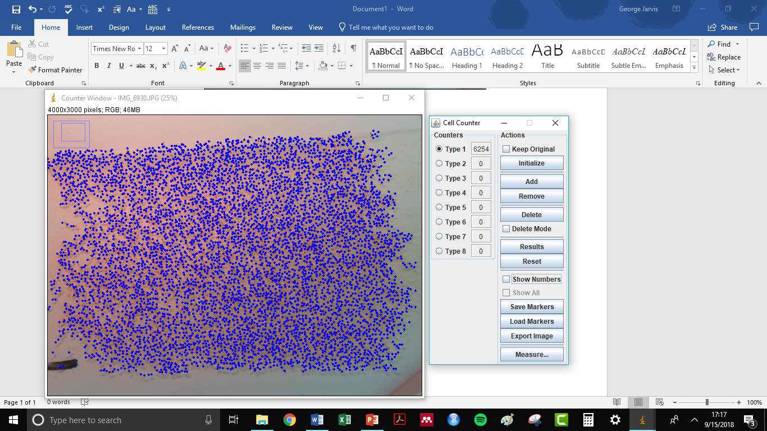
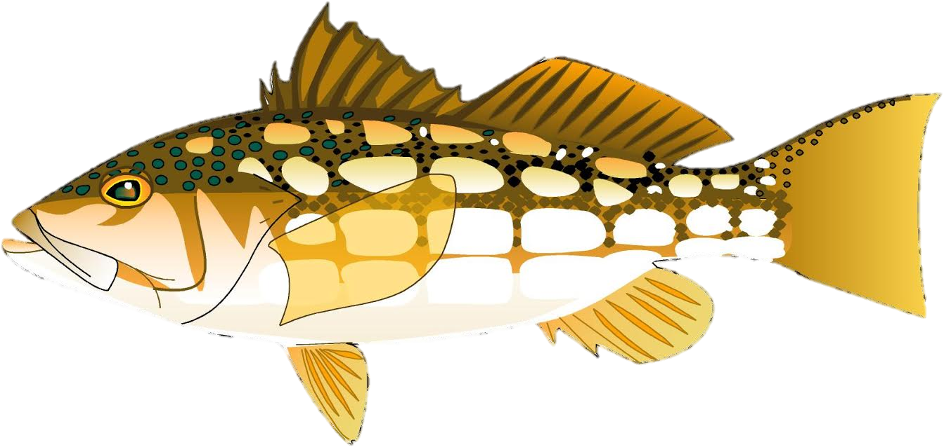
Reef surveys
Reproduction
Egg counts
Behavior
Exposure time, foraging, courtship
Recollections
Predator abundance
Risk perception
Likely perceived as threat
Not likely perceived as threat
Maurice Roper
Casey Benkwitt
Scott Hamilton
Notes:
Explain what you did for each, and then these points for why you did them
To test for differences in egg production among treatments
(visual counts) To monitor survivorship during trial, and (recollections) to see how risk affected mortality among treatments (i.e., lethal removals in high-risk reefs)
Monitored individual gobies to see how fitness behaviors may have been affected by risk
I observed gobies from the same relative distance to the reef among treatments
Foraging, courtship, number of moves
As a measure of hiding
I believe that these behaviors will be reduced in risky environments, and will help me understand the mechanism for any differences in fitness among treatments

Slide 11
Experiments
2017
18 reefs (n=6)
week-long trials
2 days of nest sampling
2018:
June + July: month-long trials
nest sampling twice per week
August:
20 reefs, added cage control (n=5)
2-week trial
nest sampling twice per week

Slide 12
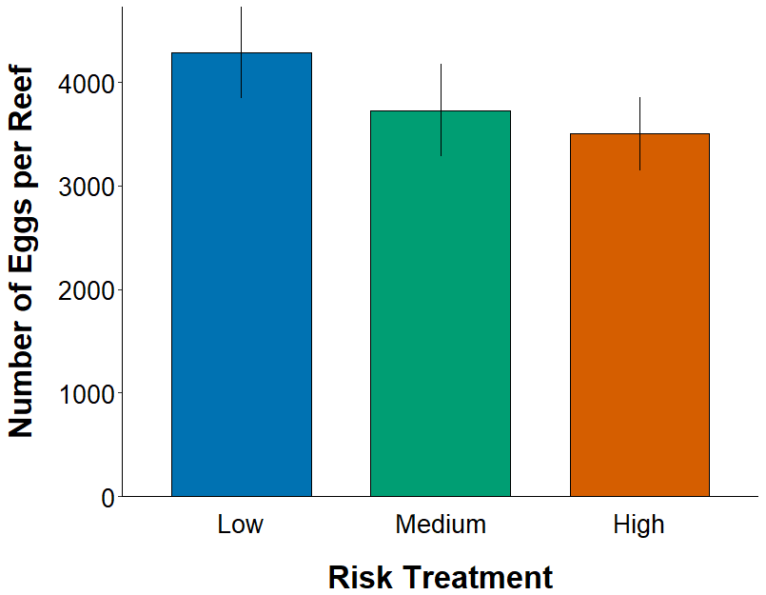
Similar reproduction among risk treatments
LMM, treatment: p = 0.19
n = 12
Notes:
Y = total egg production per reef after 1 month
X = risk treatment
Showing means and standard errors in figure
No legend needed, but mention that colors will be consistent throughout talk
Might not be statistical differences in output, but we see a trend of decreasing production with decreasing distance between predators and prey
Based on these results, might not expect to see differences in other responses. Let’s check out the surveys for mortality, first visual surveys, where I swam over each reef and counted the number of fish visible on each

Slide 13
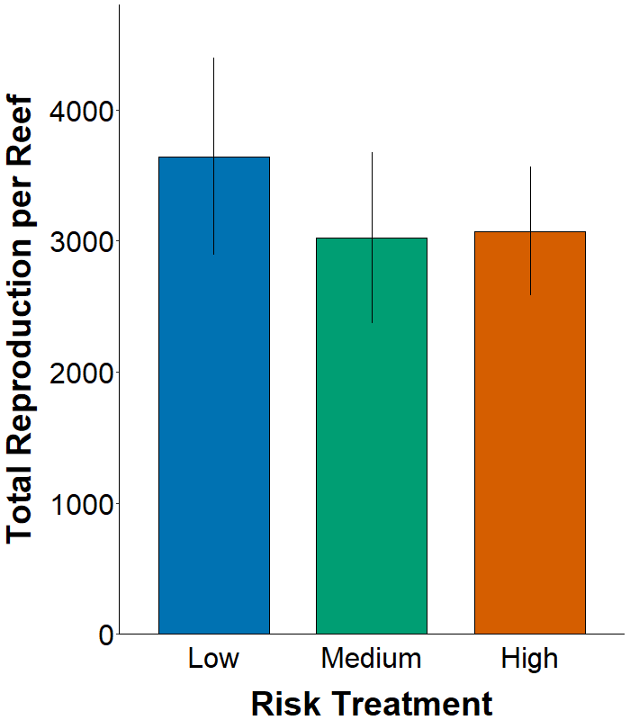
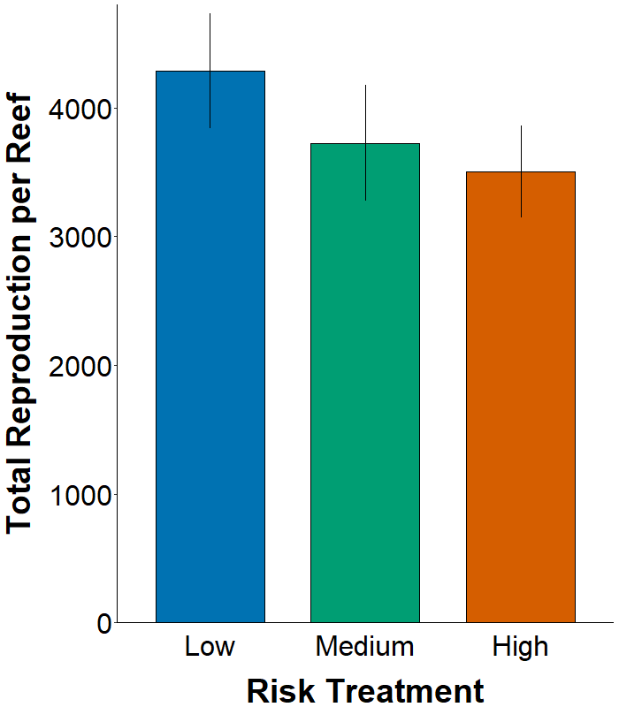
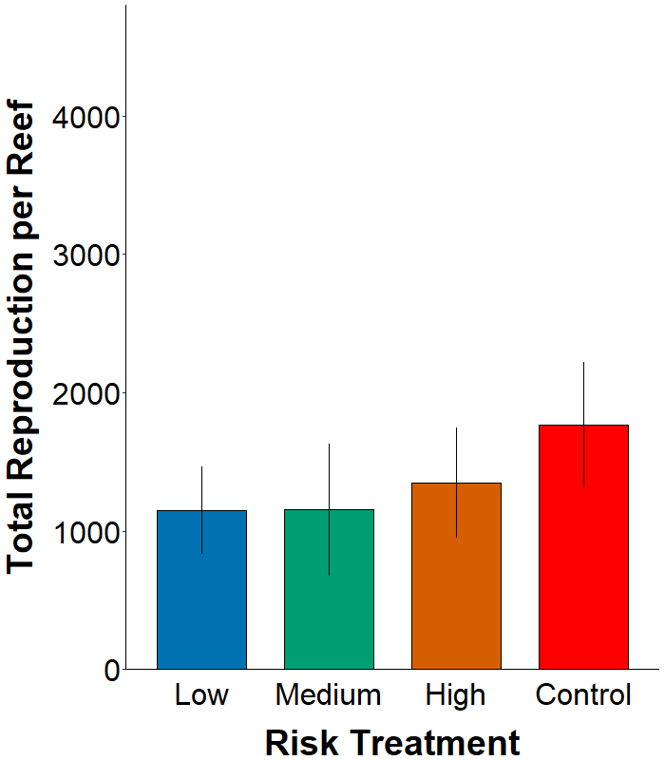
Similar reproduction among risk treatments
Notes:
Y = total egg production per reef after 1 month
X = risk treatment
Showing means and standard errors in figure
No legend needed, but mention that colors will be consistent throughout talk
Might not be statistical differences in output, but we see a trend of decreasing production with decreasing distance between predators and prey
Based on these results, might not expect to see differences in other responses. Let’s check out the surveys for mortality, first visual surveys, where I swam over each reef and counted the number of fish visible on each

Slide 14
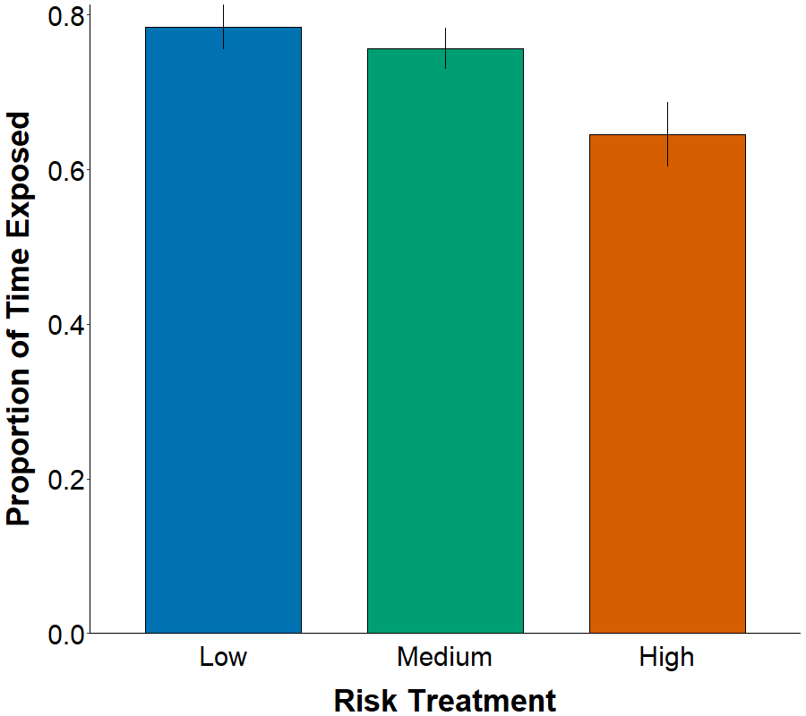
Less time exposed on high-risk reefs
a
a
ANCOVA
exposure time + density: p = 0.007
n = 108
b
Notes:
16% reduction in time exposed on reefs, which remember, is important for fitness behaviors in bluebanded gobies

Slide 15
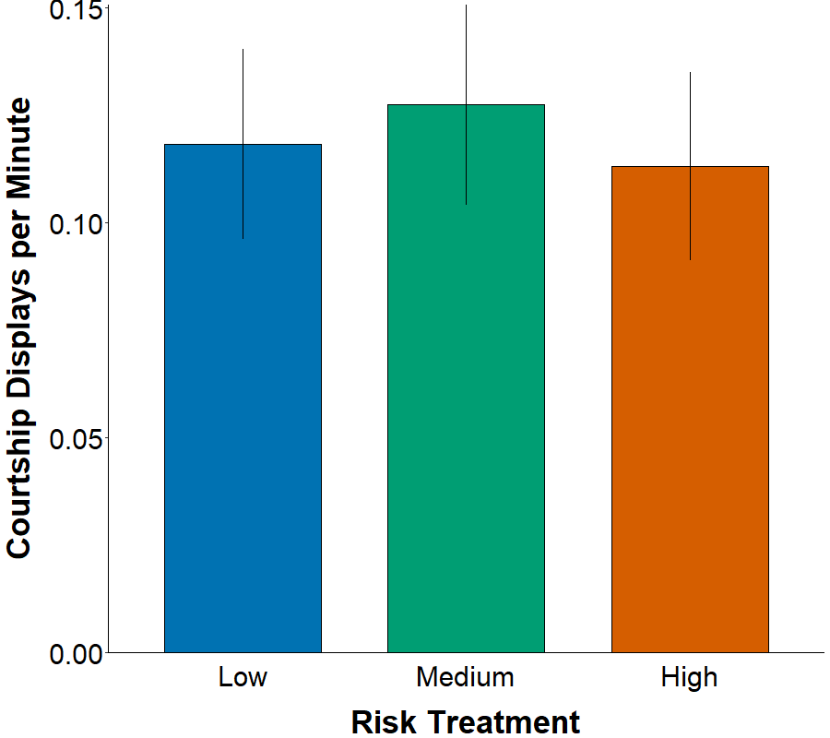
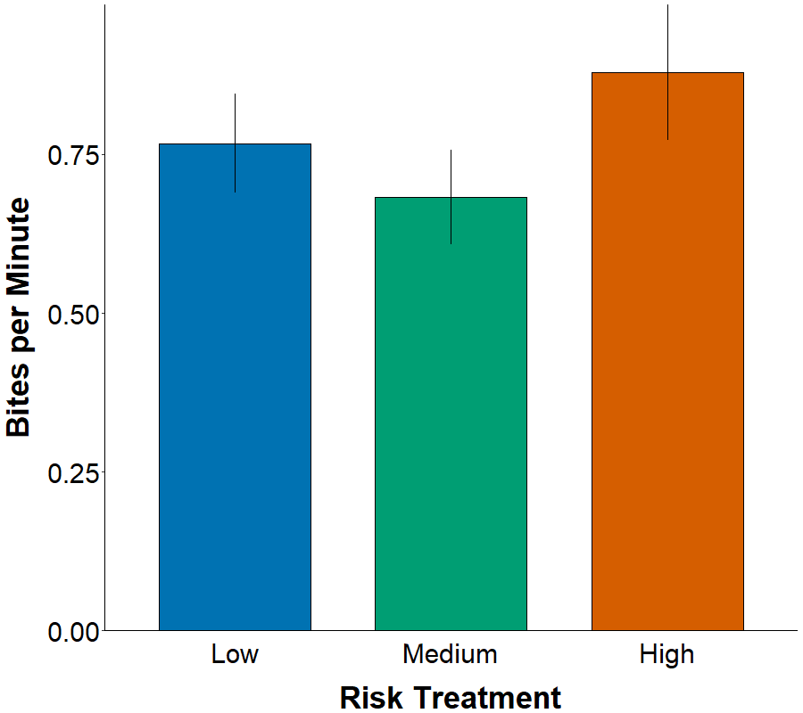
Similar courtship and foraging among treatments
p = 0.770
p = 0.276
Notes:
Results show that when courtship occurred, it was not sig. diff. among treatments

Slide 16
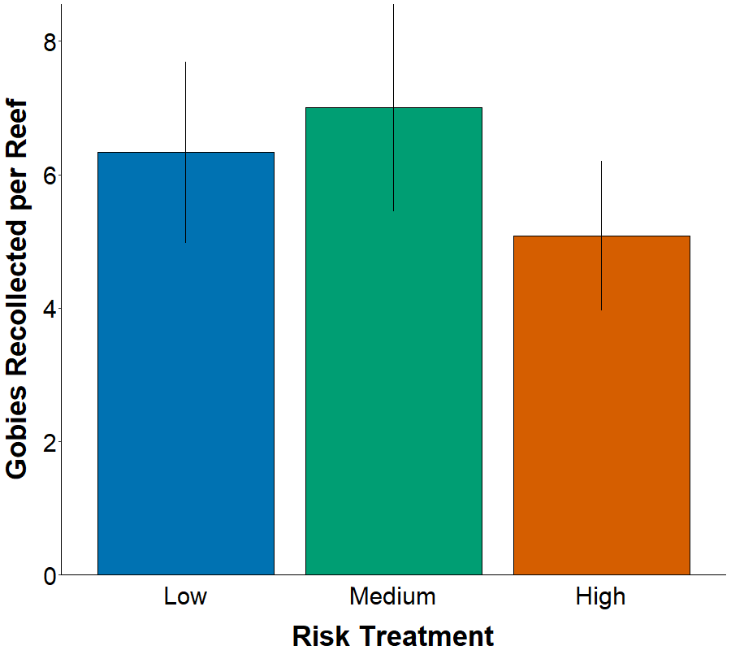
Similar recollections among treatments
GLM, treatment: p = 0.48
Suggests no lethal predation in high-risk reefs
Notes:
No legend needed, can code that out in ggplot
Recollected the same proportion of gobies from each of the three risk treatments, showing the lethal effects of predation were not likely affecting the lower counts in high-risk.

Slide 17
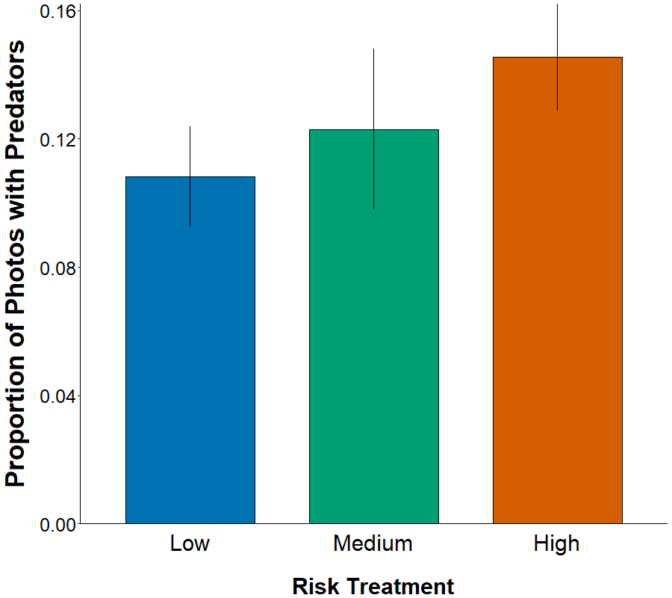
Comparable predator visitation among treatments
Likely perceived as threat
Binomial GLM
treatment: p = 0.66
n (Low, Med, High) = 6, 3, 6
Notes:
High = 0.04
Med = 0.01
Show photos of predator time lapses

Slide 18
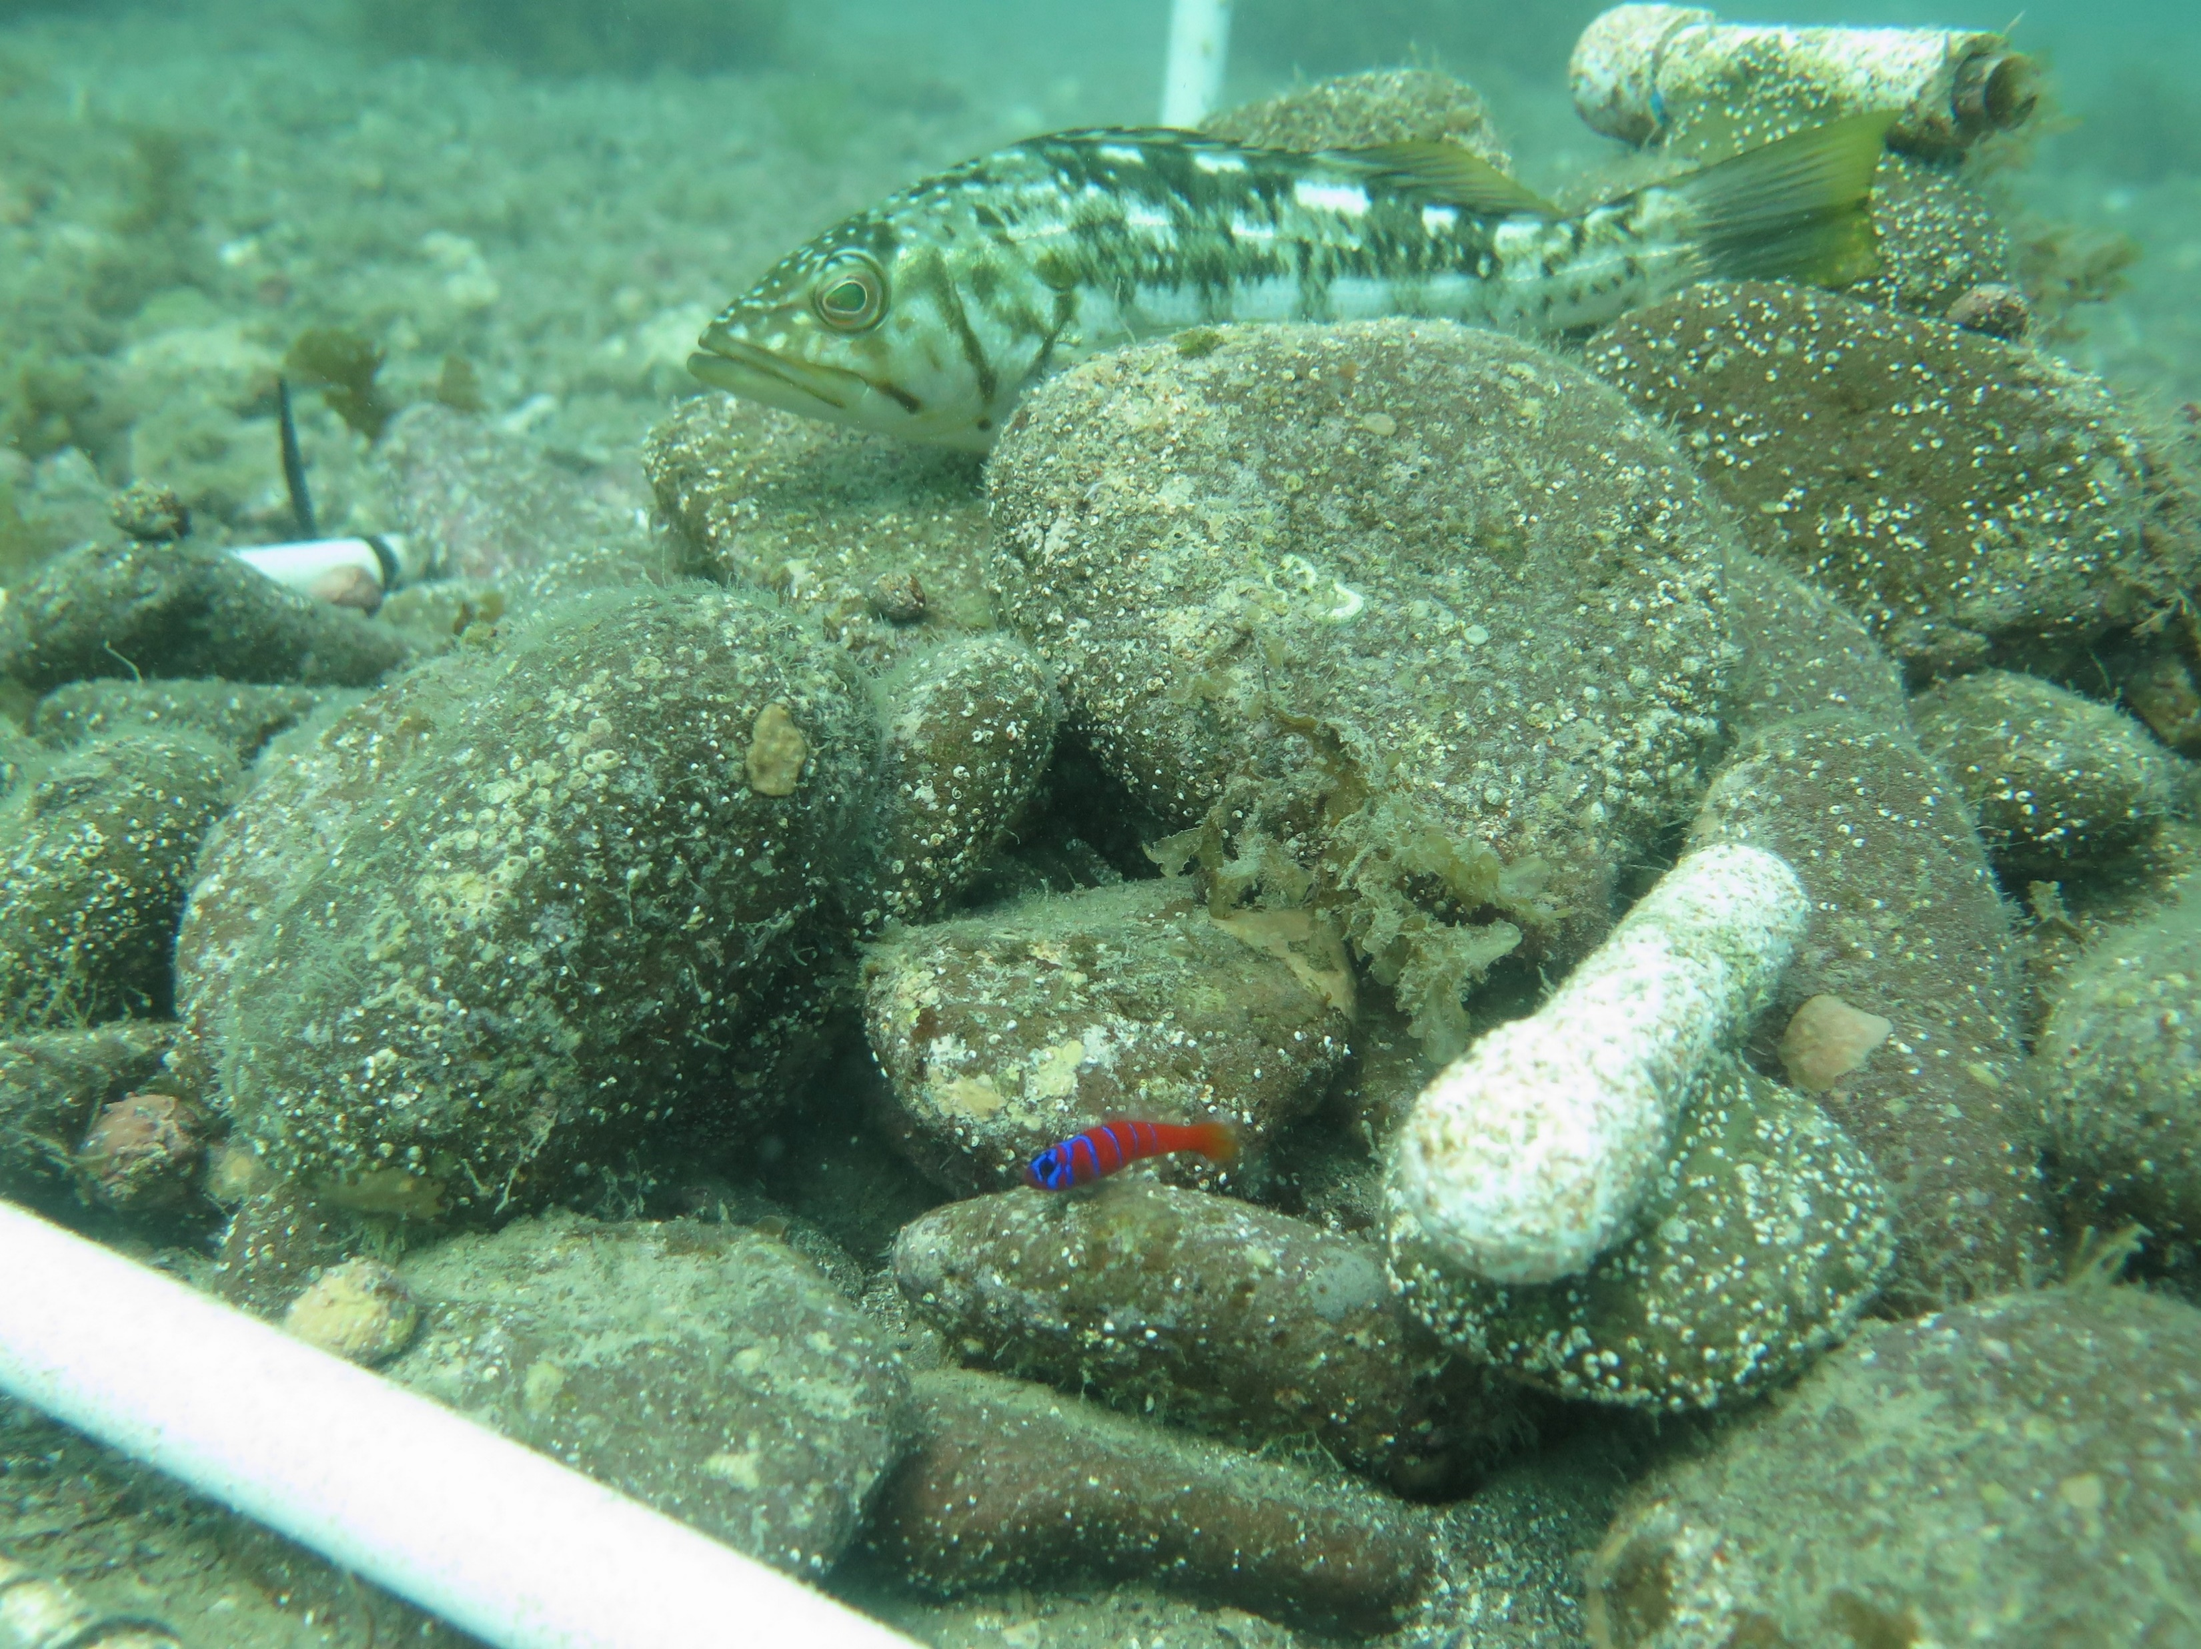
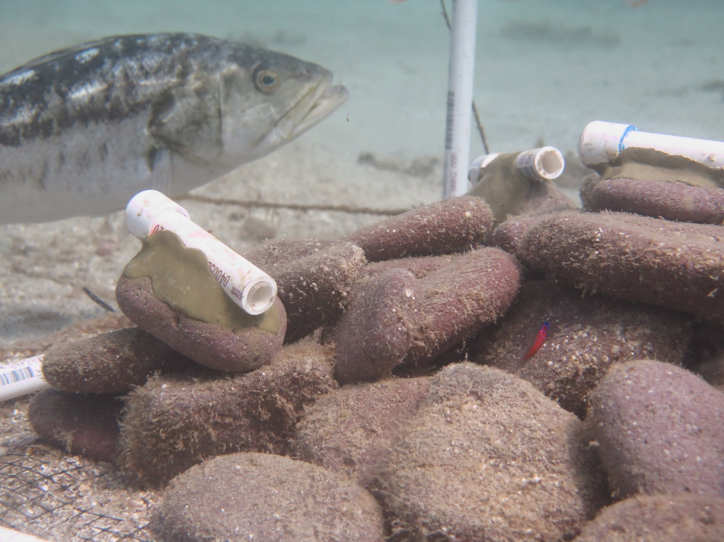
What I expected to see…

Slide 19
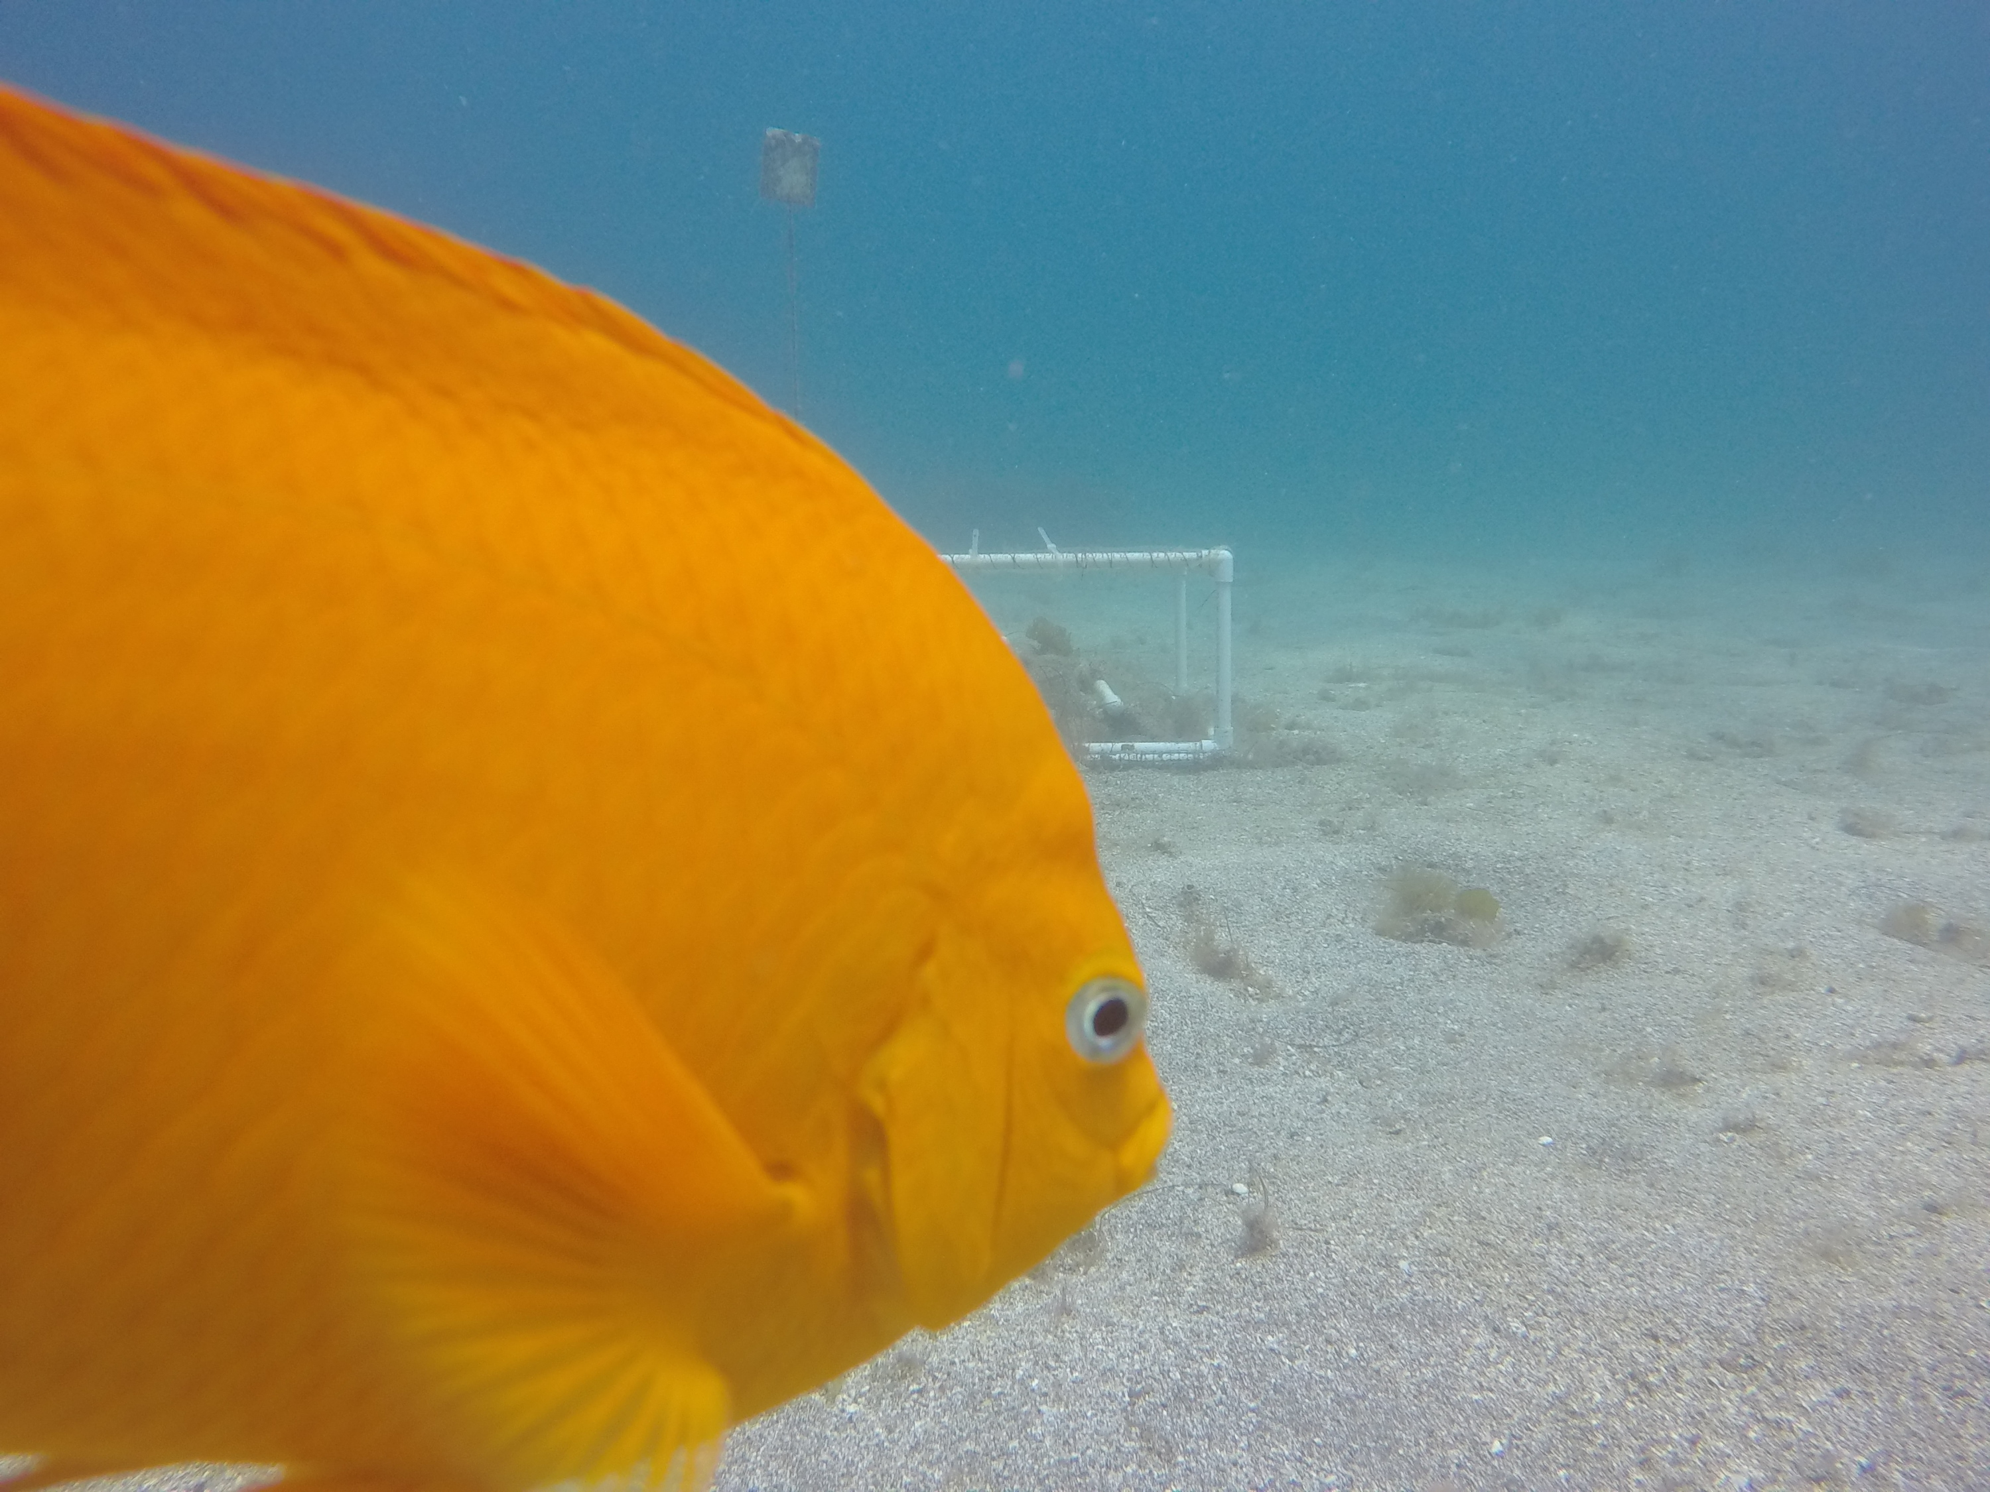
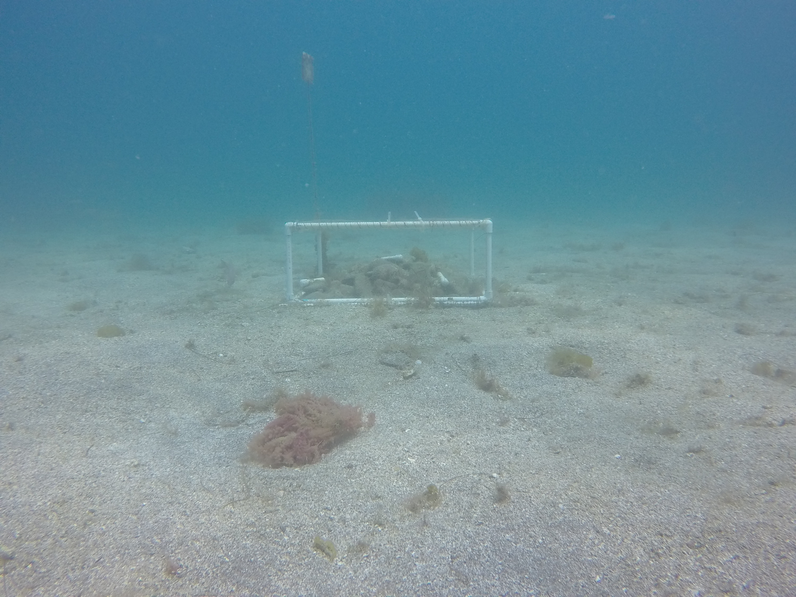
What I mostly saw…

Slide 20
Observed effects of predation risk on bluebanded gobies
Reproduction
No measurable effect on egg production
Behavior
Lower exposure
Similar effects on courtship, foraging, and survival
Notes:
Really only affected

Slide 21
Conclusions
Reproduction
No measurable effect on egg production
Behavior
Lower exposure
Similar effects on courtship, foraging, and survival
Caging artifacts
Similar effects between high-risk and cage control
Notes:
Really only affected

Slide 23
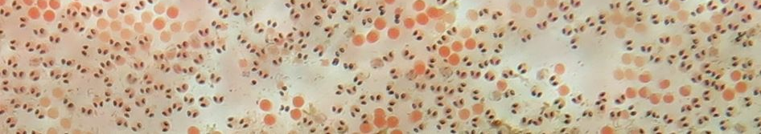
Are bluebanded gobies fearless?
Effects of predators may not have been severe enough to induce changes in fitness
Persistent risk may lead to fitness reductions
Predisposed to cope with risk?
Notes:
Talk here about how changes in exposure time were not severe enough to reduce foraging, or courtship, and those are likely the drivers of reproductive output
If there were higher predator abundances, and a higher proportion of predators perceived as a threat, we would likely see differences in courtship, and foraging that would result in lower fitness
Long-term version of this study would likely show same results, but if predator abundances were higher, I would expect to see suppressed fitness and likely higher-mortality from reduced foraging or more risky behavior in high-rick environments
3) likely due to low reproductive plasticity in BBG (only 2-year lifespan, and 8-mo repro span)
suppression could lead to severe reductions in lifetime fitness
a) Would not likely see same responses in a broadcast spawning fish (low reproductive investment), or a fish that has a longer reproductive span (able to allocate reproduction to a less risky period)

Slide 24









Acknowledgements
Steele Lab
Dr. Maria Adreani
Dr. Casey Benkwitt
Kathryn Scafidi
Ben Chubak
Erika Nava
Erin Jaco
Alexis Estrada
Russell Dauksis
Griffin Srednick
Barbara Weiser
Thesis committee
Dr. Mark Steele
Dr. Larry Allen
Dr. Casey terHorst
Research facilities
Undergraduate researchers
Emily Nixon
Hunter Ramo
Kyle Mooers
Lindsey Stockton
Taleen Gharibian
Michelle Barrios
*USC REU students
Funding organizations
Volunteer divers
Andrew Kerr
Holly Baijnauth
Max Liebergesell
Zoë Scott
Darrin Ambat
Amanda Heidt
Kenji Soto
Scott Miller
Additional support
Dr. Jameal Samhouri
Dr. Will White
Dr. Scott Hamilton
Dr. Catherine Matassa
Dr. Todd Anderson
Dr. Nyssa Silbiger
Dr. Adrian Stier
Stephen Pang

Slide 25
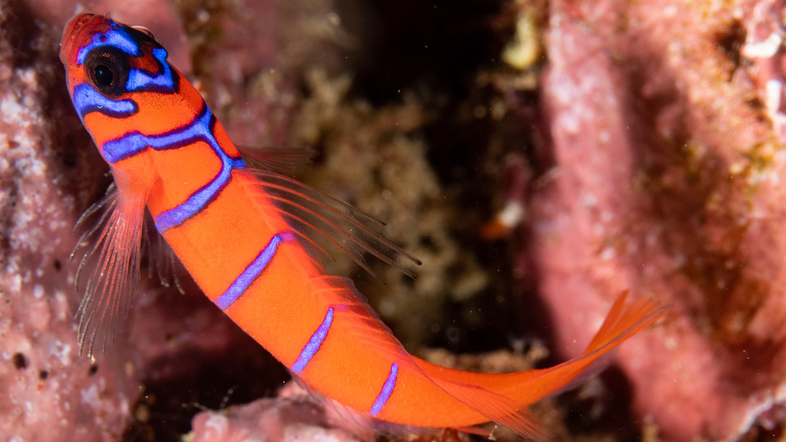
Questions?
george.jarvis.235@my.csun.edu
Maurice Roper

Slide 26
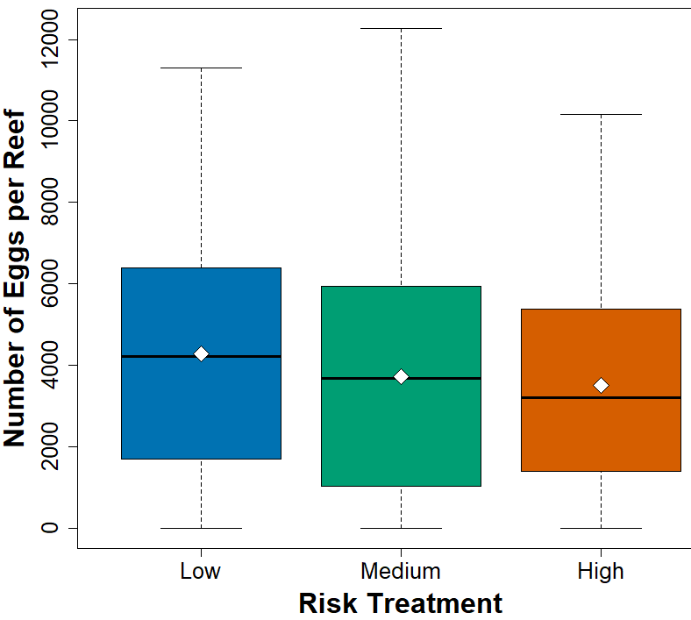
Equal reproduction among risk treatments
LMM, treatment: p = 0.19
n = 12
Notes:
Y = total egg production per reef after 1 month
X = risk treatment
Showing means and standard errors in figure
No legend needed, but mention that colors will be consistent throughout talk
Might not be statistical differences in output, but we see a trend of decreasing production with decreasing distance between predators and prey
Based on these results, might not expect to see differences in other responses. Let’s check out the surveys for mortality, first visual surveys, where I swam over each reef and counted the number of fish visible on each

Slide 27
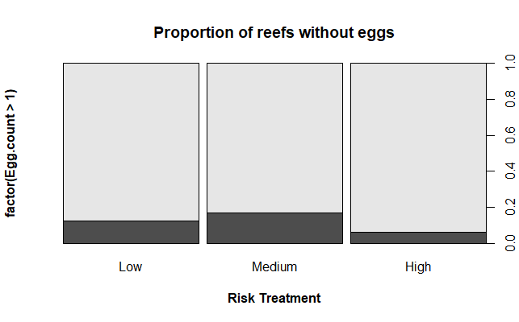

Slide 28
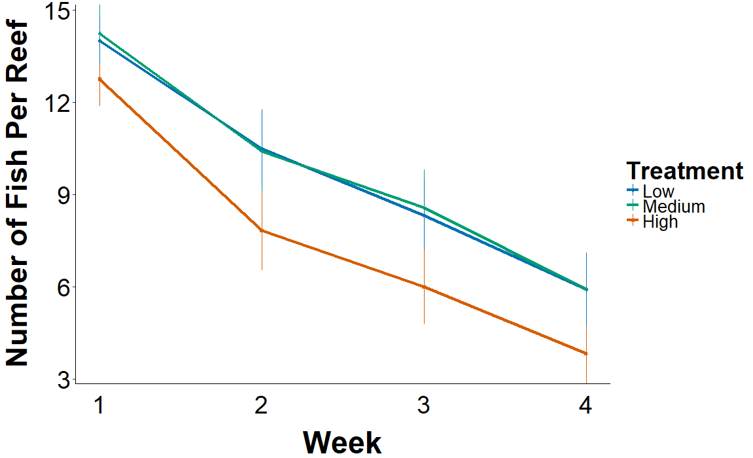
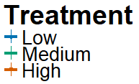
Fewer gobies observed on high-risk reefs
GLM:
treatment*time: p = 0.66
time: p < 0.001
treatment: p < 0.001
Seen 21% less frequently on high-risk reefs
Notes:
Y = number of fish seen per reef
X = week of the survey
The number of gobies seen on the reefs decreased over time, regardless of risk
However, I consistently saw fewer gobies on high-risk reefs during the experiments, 21% reduction overall
As long as predators were excluded at all (low and medium risk treatments), no changes in number of fish seen
Don’t know if the reductions in high-risk treatment were due to lethal or sublethal effects, where predators were allowed full access

Slide 29
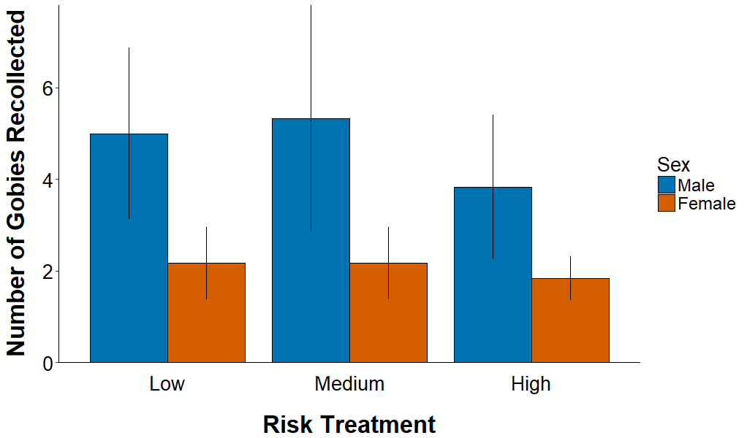
Similar recollections by sex
LMM
Fixed: treatment, sex
Random: deployment block
n=6
No effect of risk on total number recollected (p = 0.153)
Equal sex ratios among treatments (p = 0.863)
Notes:
Recollected the same proportion of gobies from each of the three risk treatments, showing that it might not be lethal predation driving the reductions in reproductive output in the high risk treatments
This is interesting, similar final recollections as ending densities observed on reefs == confirms accuracy of visual counts
Recollected similar numbers of males and females, regardless of risk
Collected about 50% morel males than females

Slide 30
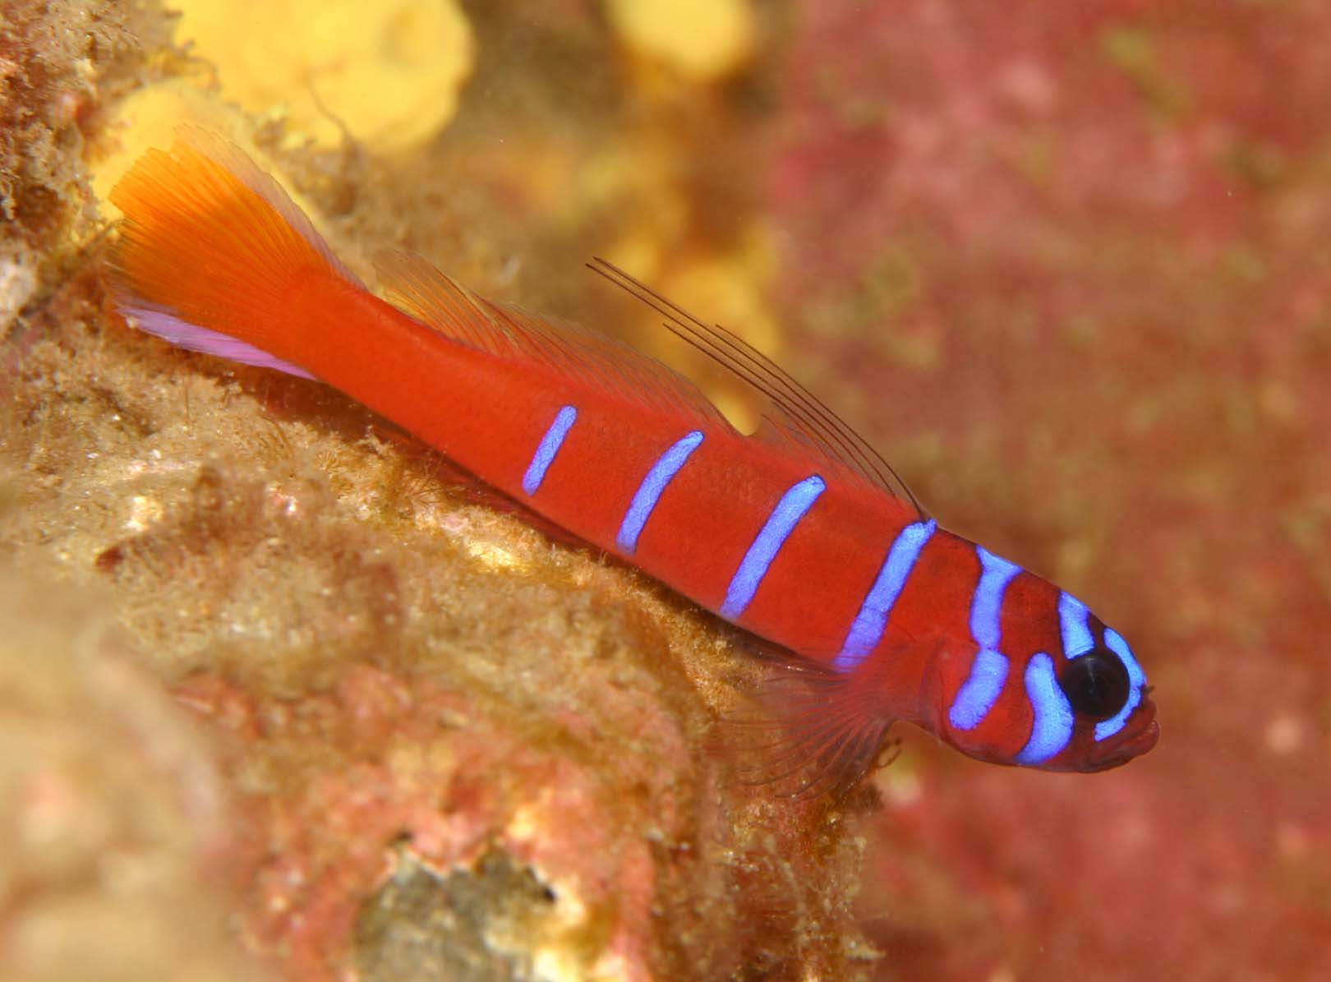
Color codes:
Size
Pink = 20’s
Blue = 30’s
Orange = 40’s
no tag <20 mm
Sex
Pink = female
Blue = male
5
4
3
2
1

Slide 31
6
7
8
9
0

